Slide 1


IMPACT OF
CAR FEATURE
ON PRICE AND PROFITABILITY
https://trainity.in

Slide 2

https://trainity.in
Agenda
01
Project Description
04
Insights
02
Approach
05
Result
03
Tech Stack Used
06
Drive Link

Slide 3

Project Description:
This project aims to investigate how various car features impact their prices and profitability in the automotive industry. By analyzing a dataset that includes information about car models, specifications, and market data, the goal is to provide insights that can help car manufacturers make more informed pricing and product development decisions.
Data Sources: The data source is the "Car Features and MSRP" dataset from Kaggle, containing details on over 11,000 car models, including make, model, year, engine specifications, transmission type, market category, fuel efficiency, popularity, and MSRP.
Data Cleaning: We ensured data accuracy and reliability by handling missing values, removing duplicates, standardizing data formats, and addressing inconsistencies.

Slide 4
Approach &
Tech Stack Used
Approach
Tech Stack Used
I employed various analytical methods, including descriptive statistics, data visualization, regression analysis, and correlation analysis, to uncover patterns and insights within the dataset.
I used regression analysis to identify key factors influencing car prices. This technique helped me quantify the relationship between independent variables (car features) and the dependent variable (car price). By examining coefficient values, I assessed the relative importance of different features.
For this project, I used Microsoft Excel for all data analysis tasks, including data cleaning, descriptive statistics, data visualization, and regression analysis. Excel's robust functions and tools enabled me to efficiently uncover insights and patterns within the dataset.

Slide 5
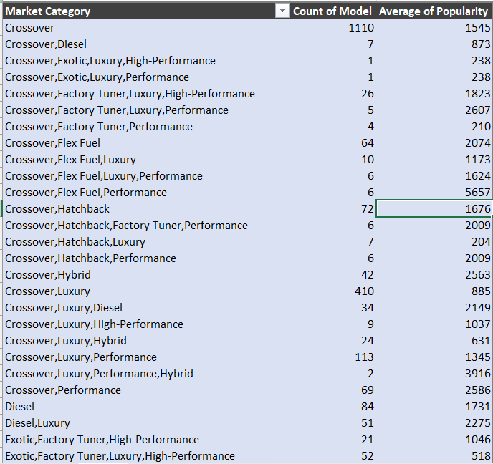
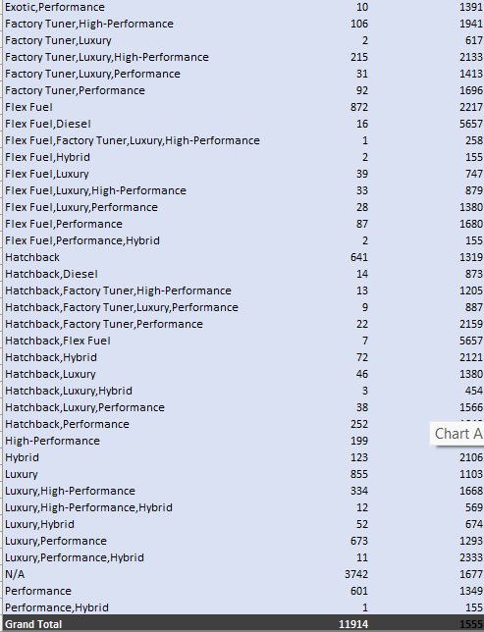
Insights:
Analysis: Task 1
How does the popularity of a car model vary across different market categories?
Task 1 A: Create a pivot table that shows no. of models in each category and average popularity score.
--> Here, I have used a pivot chart table, dragged the Category column in row section, model and popularity in the values section.

Slide 6
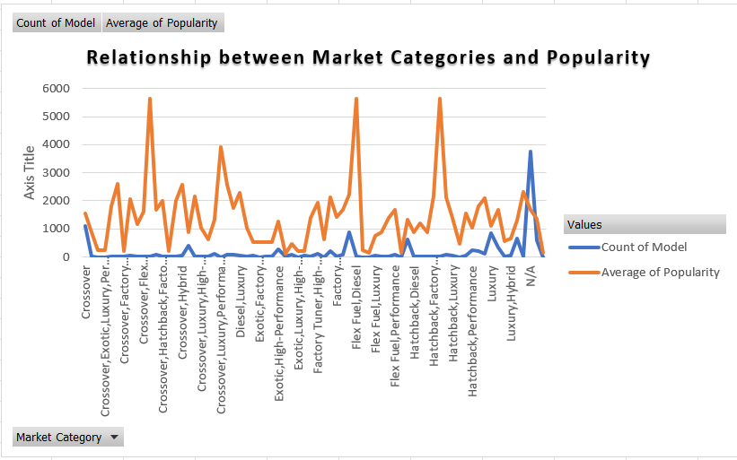
Insights:
Task 1
How does the popularity of a car model vary across different market categories?
Task 1 B: Create a combo chart to visualize a relationship between Market Categories and Popularity.
--> Here I have created a line chart which distinguish between the count of the model and Average of popularity.

Slide 7
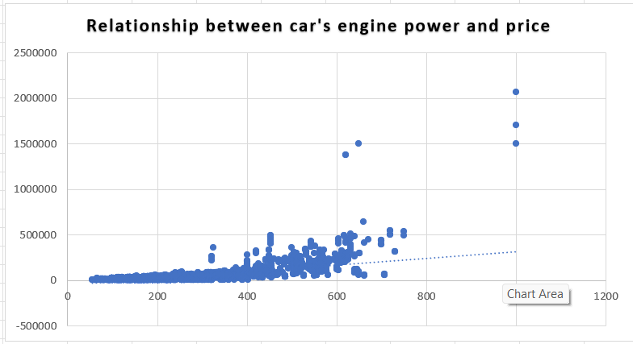
Insights:
Task 2
What is the relationship between a car's engine power and its price?
Task 2: Create a scatter plot that plots engine power on x-axis and price on y-axis. Include a trendline.

Slide 8
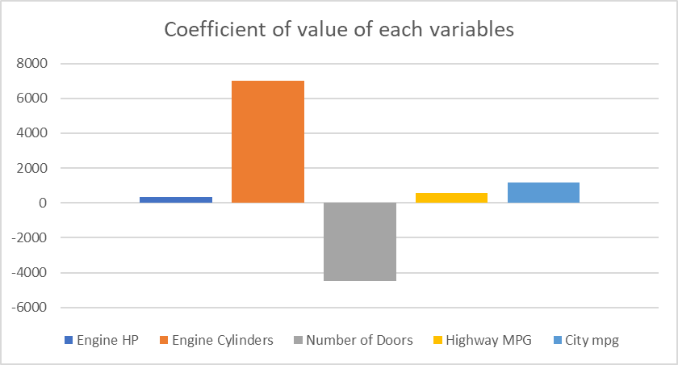
Insights:
Task 3
Which car features are most important in determining a car's price?
Task 2: Using regression analysis, identify variables that have strongest relationship with car’s price. And plot a bar graph to show the coefficient of value of each variables.

Slide 9
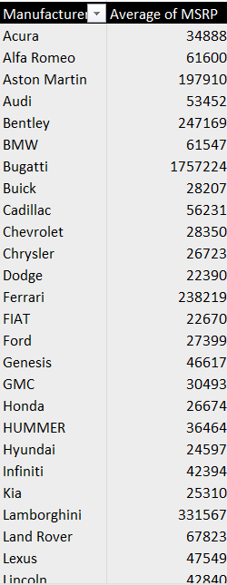
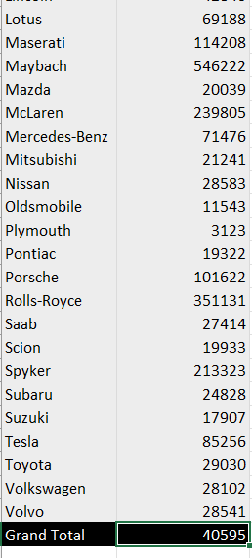
Insights:
Task 4
How does the average price of a car vary across different manufacturers?
Task 4 A: Create pivot table that shows the average price of cars for each manufracturer.
-->Here, I have created a pivot chart table, dragged manufracturer column in rows section and MSRP in value section (changed the value of price in average).

Slide 10
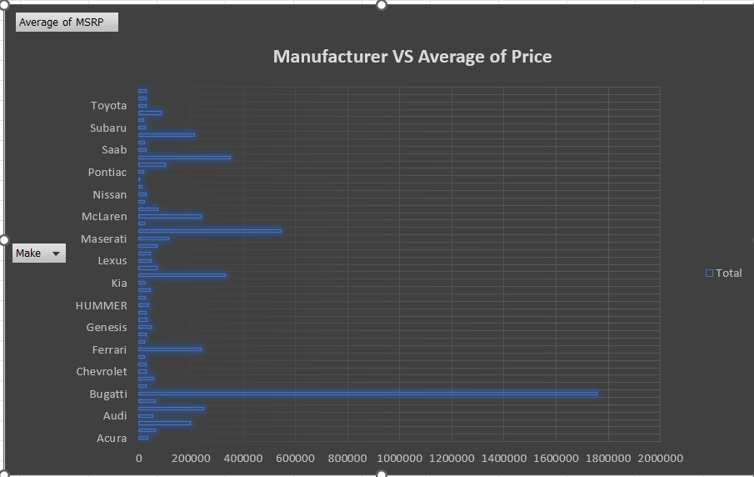
Insights:
Task 4
How does the average price of a car vary across different manufacturers?
Task 4 B: Create horizontal stacked column chart that shows the relationship between average price of cars for each manufracturer.

Slide 11
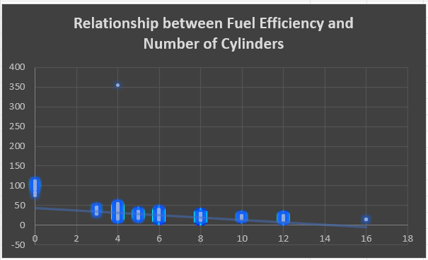
Insights:
Task 5
What is the relationship between fuel efficiency and the number of cylinders in a car's engine?
Task 5 A: Create a scatter plot with number of cylinders in x-axis and highway MPG in y axis also include the trendline.

Slide 12
Insights:
Task 5
What is the relationship between fuel efficiency and the number of cylinders in a car's engine?
Formula for the correlation:
Task 5 B: Calculate the correlation coefficient between number of cylinders highway MPG to quantify the strength and direction of the relationship.

Slide 13
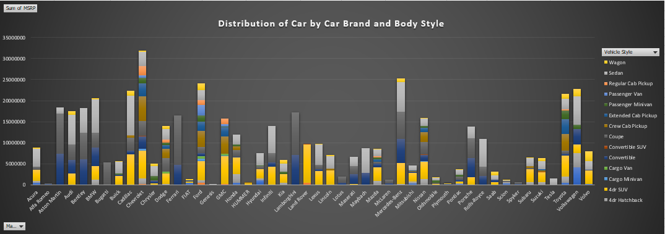
Building The Dashboard Task 1
Insights:
How does the distribution of car prices vary by brand and body style?

Slide 14
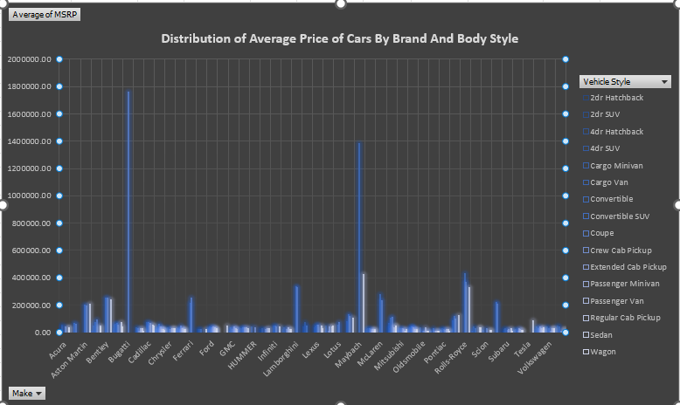
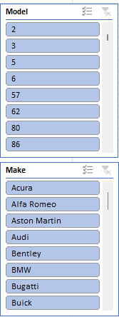
Building The Dashboard Task 2
Insights:
Which car brands have the highest and lowest average MSRPs, and how does this vary by body style?

Slide 15
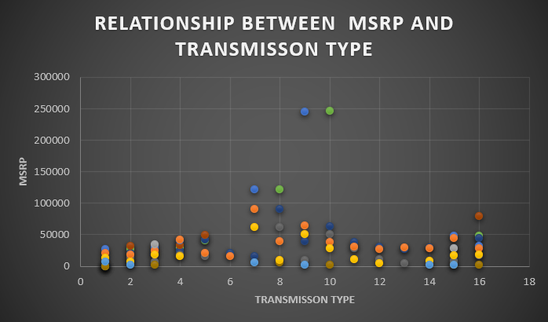
Building The Dashboard Task 3
Insights:
How do the different feature such as transmission type affect the MSRP, and how does
this vary by body style?

Slide 16
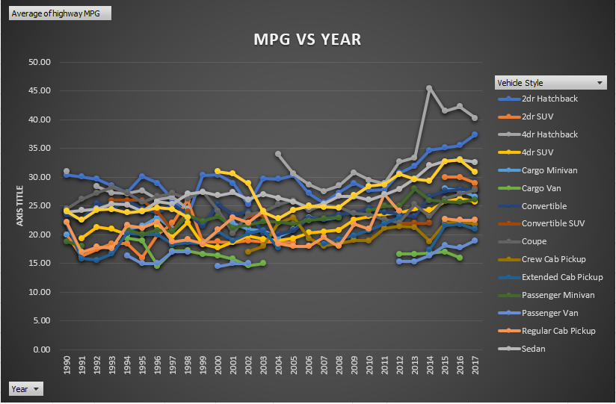
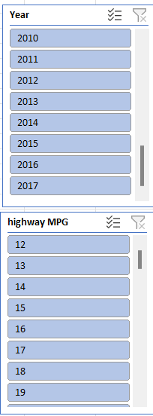
Building The Dashboard Task 4
Insights:
How does the fuel efficiency of cars vary across different body styles and model years?

Slide 17
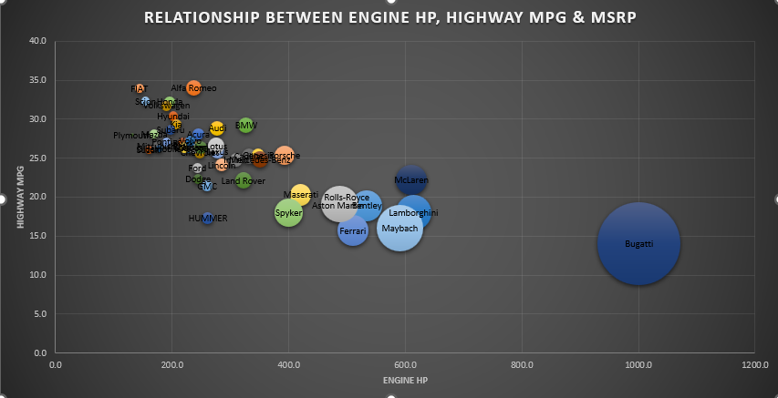
Building The Dashboard Task 5
Insights:
How does the car's horsepower, MPG, and price vary across different Brands?

Slide 18
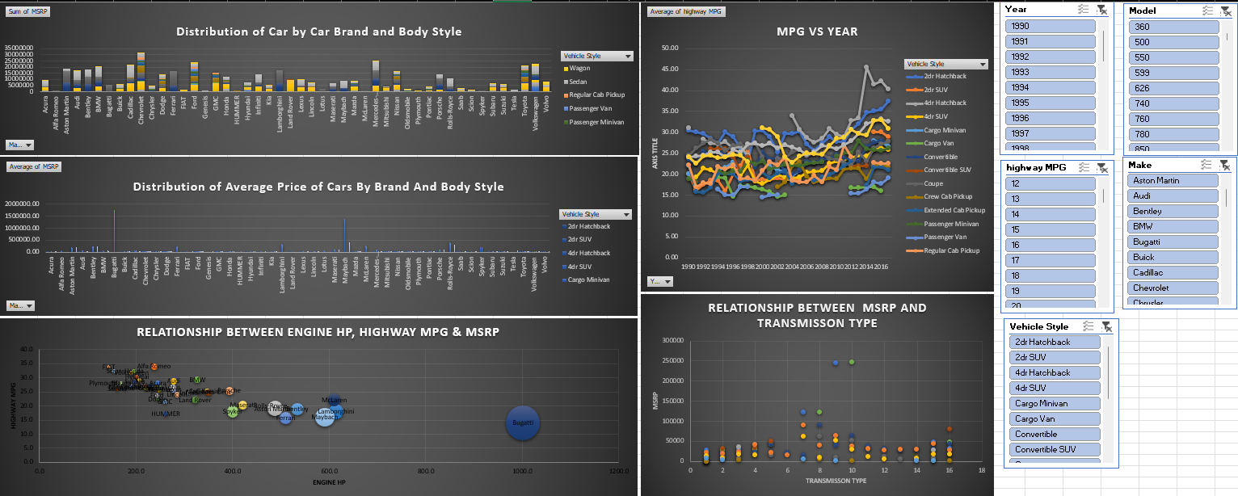
Insights:
Dashboard

Slide 19

Results:
I used visualizations such as pivot tables, scatter plots, and bar charts to present the analysis results. These visualizations help stakeholders interpret the findings more effectively and facilitate decision-making.
Consumer Preferences: I identified the features most valued by consumers, such as fuel efficiency and engine specifications.
Pricing Dynamics: The analysis showed how different features affect car prices, with certain specifications leading to higher MSRPs.
Market Trends: I observed trends over time, such as shifts in popularity for specific car types or features.

Slide 20

Drive Link:
Link of the dataset with all the solutions: https://docs.google.com/spreadsheets/d/133DG5Xaw650rKU8rQ_vpFq91YapwUzOF/edit?usp=drive_link&ouid=104159851622002118898&rtpof=true&sd=true
Link of raw dataset :
https://docs.google.com/spreadsheets/d/1h8kQ-qzMSDdqEzjt_g4mD1m3kyfGe08v/edit?usp=drive_link&ouid=104159851622002118898&rtpof=true&sd=true

Slide 21


THANK YOU
komalbarhate2004@gmail.com
https://www.linkedin.com/in/komal-barhate-18a36225a/

